Slide 1

Reactive Extensions

Slide 2
Reactive Extensions
Qu’est ce que c’est ?

Slide 3

Itérateur asynchrone

Slide 4
Itérateur asynchrone

Slide 5
Itérateur
Fournisseur
Client

Slide 6
Itérateur
Fournisseur
Client
next()

Slide 7
Itérateur
Fournisseur
Client
next()
return

Slide 8
Itérateur
Fournisseur
Client
next()
return
next()

Slide 9
Itérateur
Fournisseur
Client
next()
return
next()
return

Slide 10
Itérateur
Fournisseur
Client
next()
return
next()
return
next()

Slide 11
Itérateur
Fournisseur
Client
next()
return
next()
return
next()
return

Slide 12
Itérateur
synchrone
Fournisseur
Client
next()
return
blocage…
next()
blocage…
return
next()
return
blocage…

Slide 13
Itérateur
asynchrone
Fournisseur
Client

Slide 14
Itérateur
asynchrone
Fournisseur
Client
subscribe()

Slide 15
Itérateur
asynchrone
Fournisseur
Client
subscribe()
onNext()

Slide 16
Itérateur
asynchrone
Fournisseur
Client
subscribe()
onNext()
onNext()

Slide 17
Itérateur
asynchrone
Fournisseur
Client
subscribe()
onNext()
onNext()
onNext()

Slide 18
Itérateur
asynchrone
Fournisseur
Client
subscribe()
onNext()
blocage…
onNext()
blocage…
onNext()

Slide 19
Itérateur
asynchrone
Observable
Observer
subscribe()
onNext()
onNext()
onNext()

Slide 20

Iterator, Observer ?

Slide 21


Slide 22
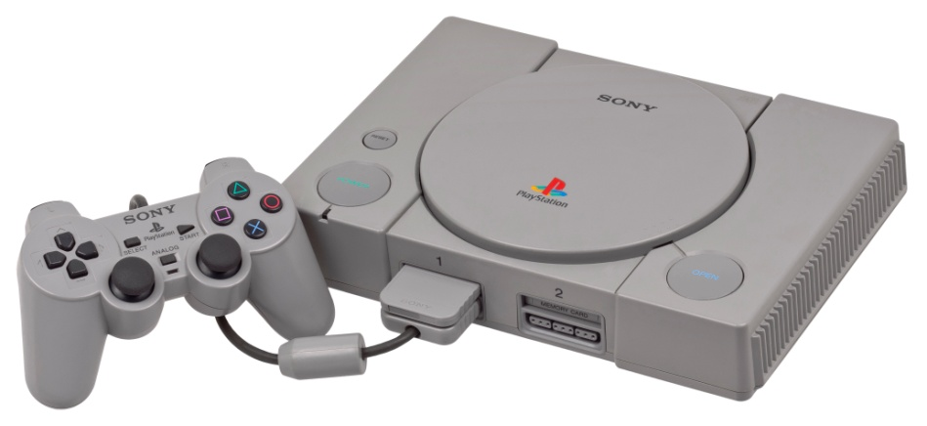
1994

Slide 23


Iterator
Fournisseur
Client
Observer

Slide 24
Iterator
PULL
Fournisseur
Client
PUSH
Observer

Slide 25
Iterator
Observer
T next()
onNext(T)
throws Exception()
onError(Exception)
!hasNext()
onCompleted()

Slide 26
Un exemple ?

Slide 27
List<String> names = {Bruce, Peter, Clark}
Observable.from(names).subscribe(
new Action1<String>() {
public void call(String s) {
System.out.println("Hello " + s + "!");
}
});
> Hello Bruce !
> Hello Peter !
> Hello Clark !

Slide 28
List<String> names = {Bruce, Peter, Clark}
Observable.from(names).subscribe(
new Action1<String>() {
public void call(String s) {
System.out.println("Hello " + s + "!");
}
});
Créé un Observable
> Hello Bruce !
> Hello Peter !
> Hello Clark !

Slide 29
List<String> names = {Bruce, Peter, Clark}
Observable.from(names).subscribe(
new Action1<String>() {
public void call(String s) {
System.out.println("Hello " + s + "!");
}
});
Ceci est un Observer
> Hello Bruce !
> Hello Peter !
> Hello Clark !

Slide 30
List<String> names = {Bruce, Peter, Clark}
Observable.from(names).subscribe(
new Action1<String>() {
public void call(String s) {
System.out.println("Hello " + s + "!");
}
});
> Hello Bruce !
> Hello Peter !
> Hello Clark !

Slide 31
List<String> names = {Bruce, Peter, Clark}
Observable.from(names).subscribe(
(s) -> {System.out.println("Hello " + s + "!");}
);
> Hello Bruce !
> Hello Peter !
> Hello Clark !

Slide 32
Names
List<String> names = {Bruce, Peter, Clark}
Observable.from(names).subscribe(
(s) -> {System.out.println("Hello " + s + "!");}
);
> Hello Bruce !
> Hello Peter !
> Hello Clark !

Slide 33
Names
Print()
List<String> names = {Bruce, Peter, Clark}
Observable.from(names).subscribe(
(s) -> {System.out.println("Hello " + s + "!");}
);
> Hello Bruce !
> Hello Peter !
> Hello Clark !

Slide 34
Names
Print()
List<String> names = {Bruce, Peter, Clark}
Observable.from(names).subscribe(
(s) -> {System.out.println("Hello " + s + "!");}
);
> Hello Bruce !
> Hello Peter !
> Hello Clark !

Slide 35
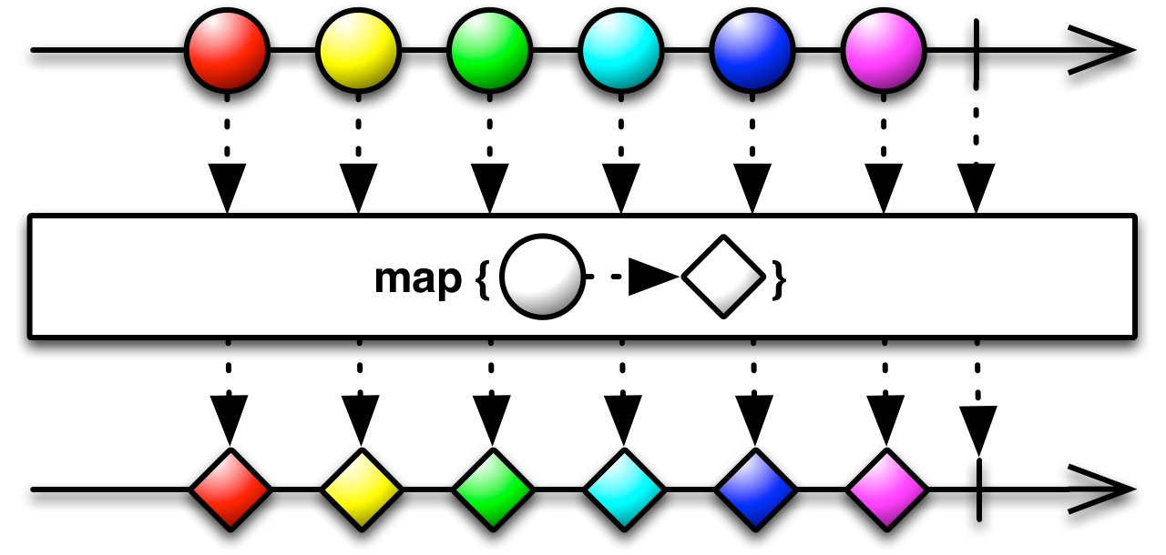
Map

Slide 36
Names
GetIdentity()
Print()
List<String> names = {Bruce, Peter, Clark}
Observable.from(names)
.map(
(name) -> {return NSAService.getIdentity(name);}
)
.subscribe(
(s) -> {System.out.println("Hello " + s + "!");}
);
> Hello Hulk !
> Hello Spiderman !
> Hello Superman !

Slide 37
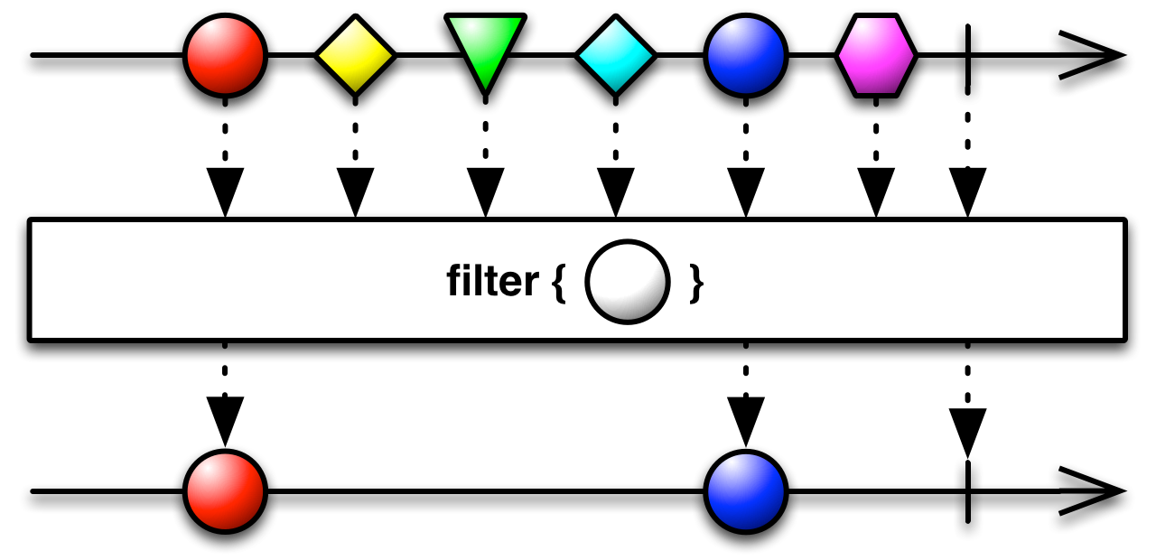
Filter

Slide 38
Names
GetIdentity()
isAnAvenger()
Print()
List<String> names = {Bruce, Peter, Clark}
Observable.from(names)
.map(
(name) -> {return NSAService.getIdentity(name);}
)
.filter(
(hero) -> {return Avengers.contains(hero);}
)
.subscribe(
(s) -> {System.out.println("Hello " + s + "!");}
);
> Hello Hulk !
> Hello Spiderman !

Slide 39
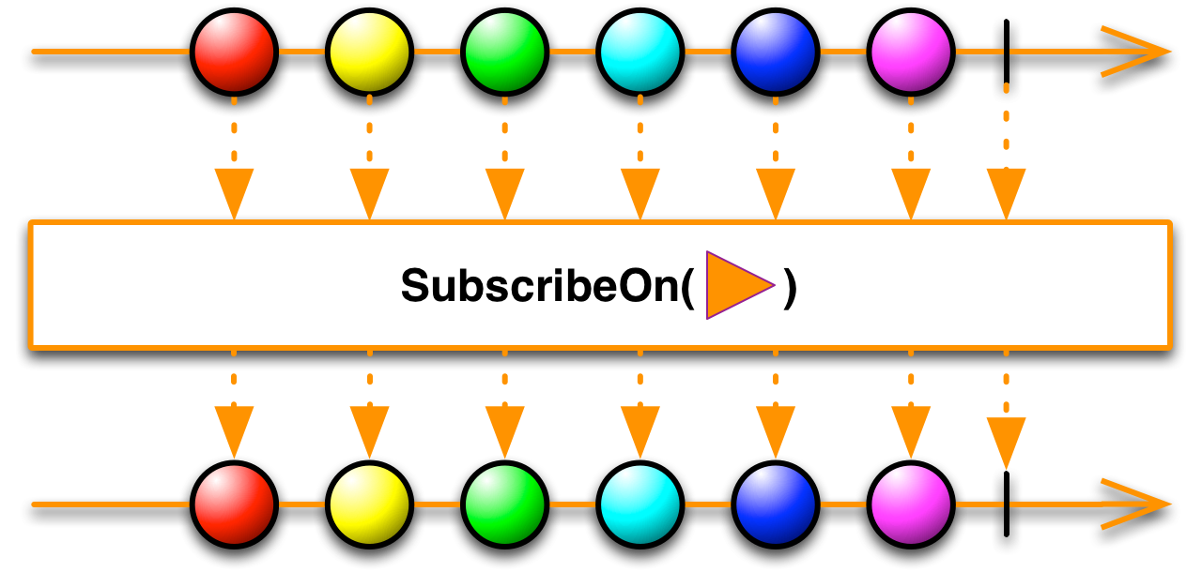
SubscribeOn

Slide 40
Names
GetIdentity()
isAnAvenger()
Print()
List<String> names = {Bruce, Peter, Clark}
Observable.from(names)
.subscribeOn(Schedulers.newThread())
.map(
(name) -> {return NSAService.getIdentity(name);}
)
.filter(
(hero) -> {return Avengers.contains(hero);}
)
.subscribe(
(s) -> {System.out.println("Hello " + s + "!");}
);
> Hello Spiderman !
> Hello Hulk !
> Hello Hulk !
> Hello Spiderman !

Slide 41
Names
GetIdentity()
isAnAvenger()
Print()
List<String> names = {Bruce, Peter, Clark}
Observable.from(names)
.subscribeOn(Schedulers.computation())
.map(
(name) -> {return NSAService.getIdentity(name);}
)
.filter(
(hero) -> {return Avengers.contains(hero);}
)
.subscribe(
(s) -> {System.out.println("Hello " + s + "!");}
);
> Hello Spiderman !
> Hello Hulk !
> Hello Hulk !
> Hello Spiderman !

Slide 42
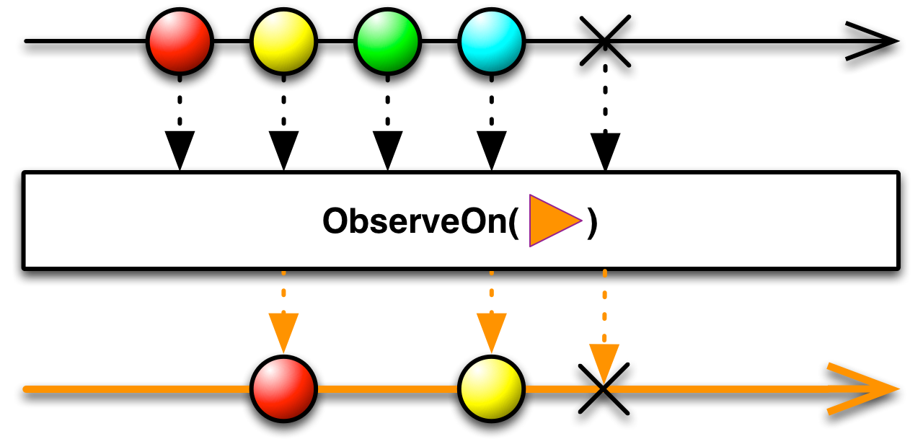
ObserveOn

Slide 43
Names
GetIdentity()
isAnAvenger()
Print()
List<String> names = {Bruce, Peter, Clark}
Observable.from(names)
.subscribeOn(Schedulers.computation())
.map(
(name) -> {return NSAService.getIdentity(name);}
)
.filter(
(hero) -> {return Avengers.contains(hero);}
)
.subscribe(
(s) -> {androidListView.getModel().addElement(s);}
);

Slide 44
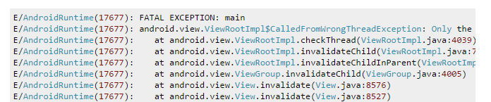
Names
GetIdentity()
isAnAvenger()
Print()
List<String> names = {Bruce, Peter, Clark}
Observable.from(names)
.subscribeOn(Schedulers.computation())
.map(
(name) -> {return NSAService.getIdentity(name);}
)
.filter(
(hero) -> {return Avengers.contains(hero);}
)
.subscribe(
(s) -> {androidListView.getModel().addElement(s);}
);

Slide 45
Names
GetIdentity()
isAnAvenger()
Print()
List<String> names = {Bruce, Peter, Clark}
Observable.from(names)
.subscribeOn(Schedulers.computation())
.map(
(name) -> {return NSAService.getIdentity(name);}
)
.filter(
(hero) -> {return Avengers.contains(hero);}
)
.subscribe(
(s) -> {androidListView.getModel().addElement(s);}
);
coubaple

Slide 46
Names
GetIdentity()
isAnAvenger()
Print()
List<String> names = {Bruce, Peter, Clark}
Observable.from(names)
.subscribeOn(Schedulers.computation())
.map(
(name) -> {return NSAService.getIdentity(name);}
)
.filter(
(hero) -> {return Avengers.contains(hero);}
)
.observeOn(AndroidSchedulers.mainThread())
.subscribe(
(s) -> {androidListView.getModel().addElement(s);}
);

Slide 47
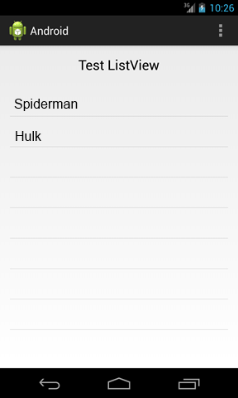
Names
GetIdentity()
isAnAvenger()
Print()
List<String> names = {Bruce, Peter, Clark}
Observable.from(names)
.subscribeOn(Schedulers.computation())
.map(
(name) -> {return NSAService.getIdentity(name);}
)
.filter(
(hero) -> {return Avengers.contains(hero);}
)
.observeOn(AndroidSchedulers.mainThread())
.subscribe(
(s) -> {androidListView.getModel().addElement(s);}
);

Slide 48
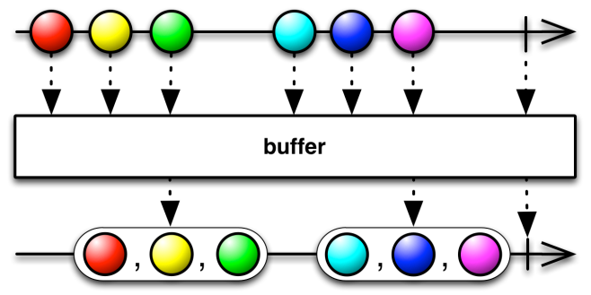
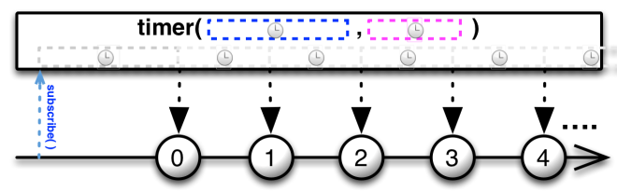
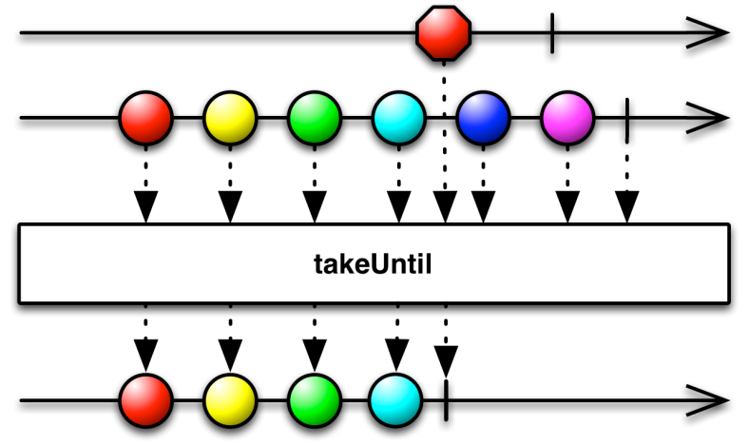
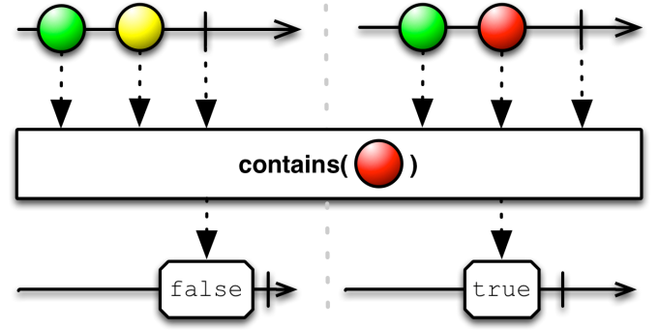
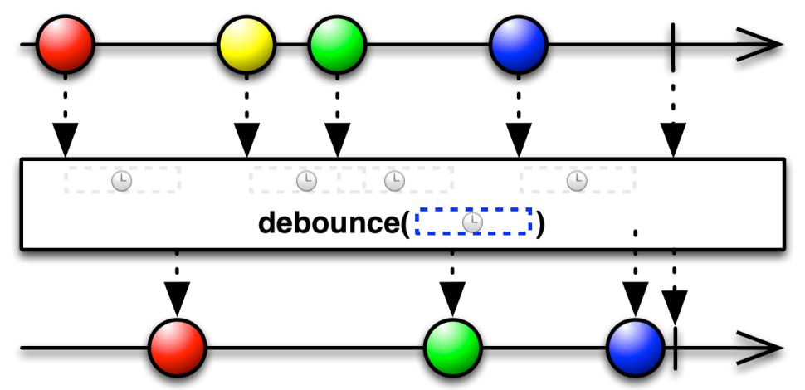
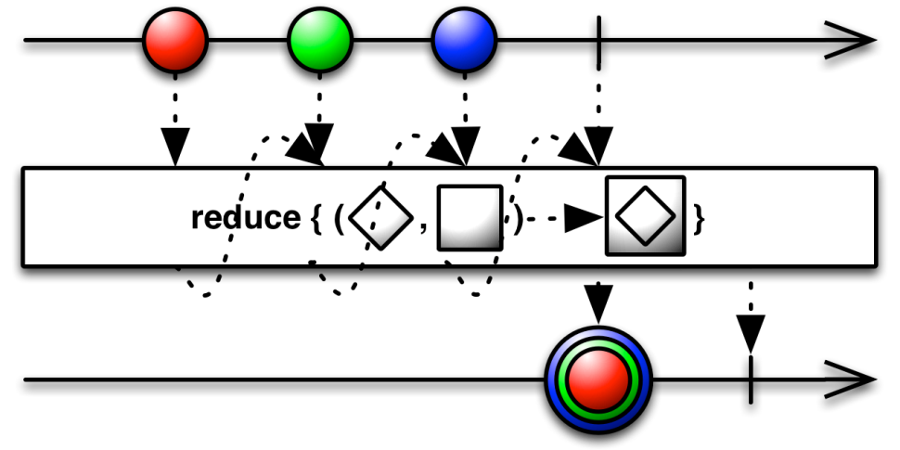
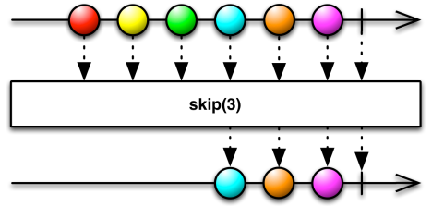

Slide 49


Slide 50

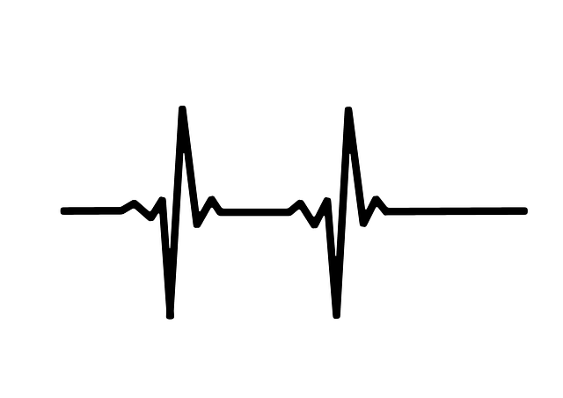



Sensor
Network Emitter
Network Receiver
GUI

Slide 51
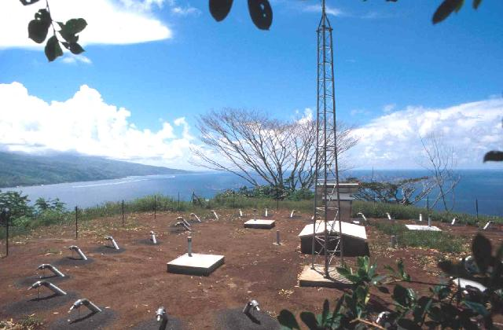

Slide 52
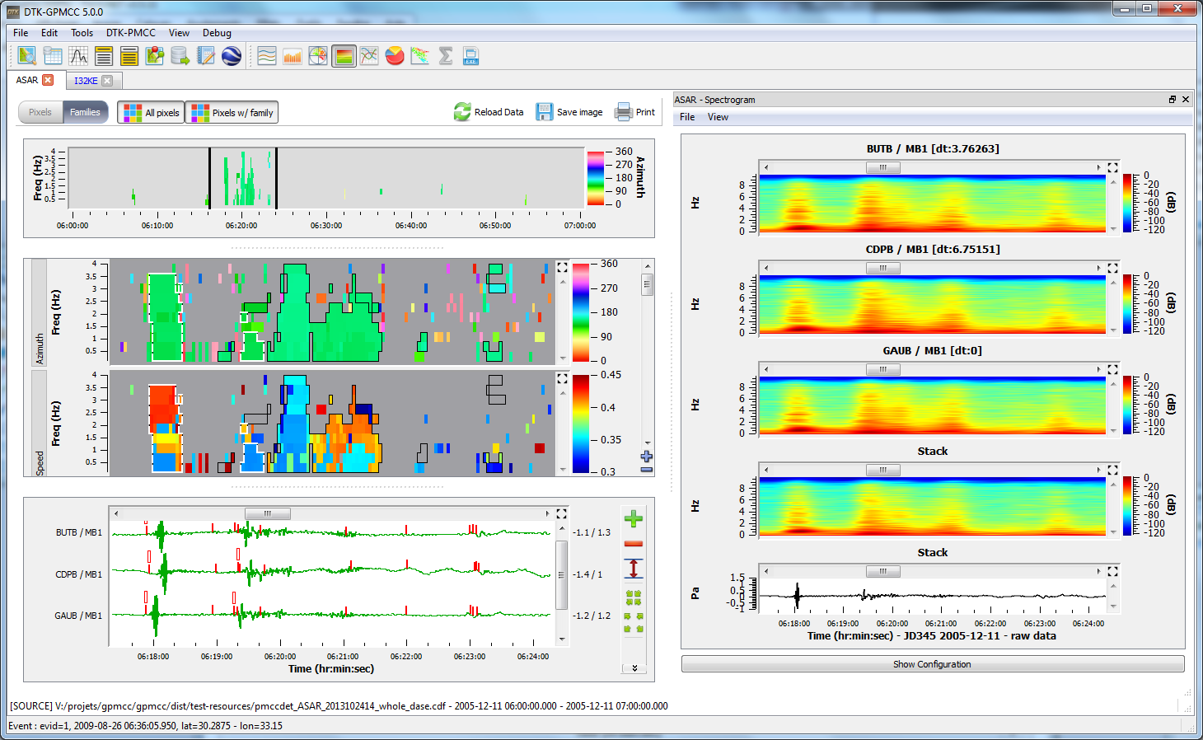

Slide 53
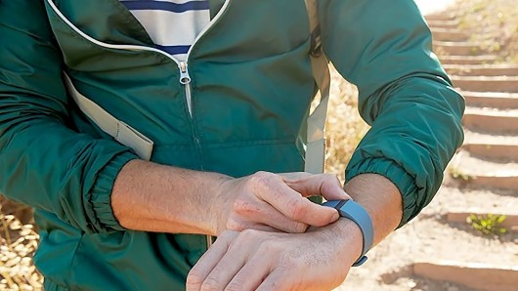

Slide 54
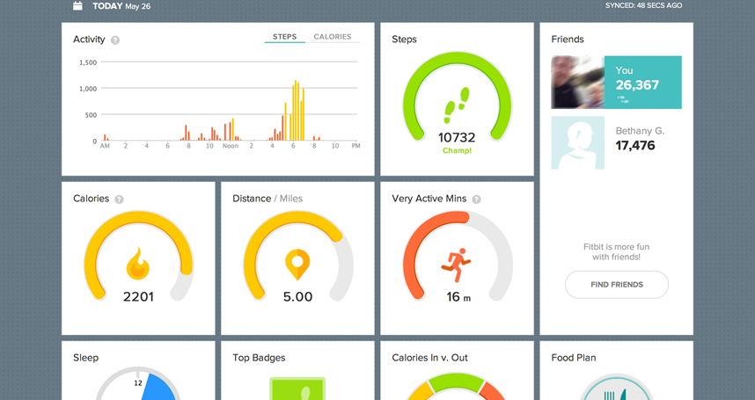

Slide 55
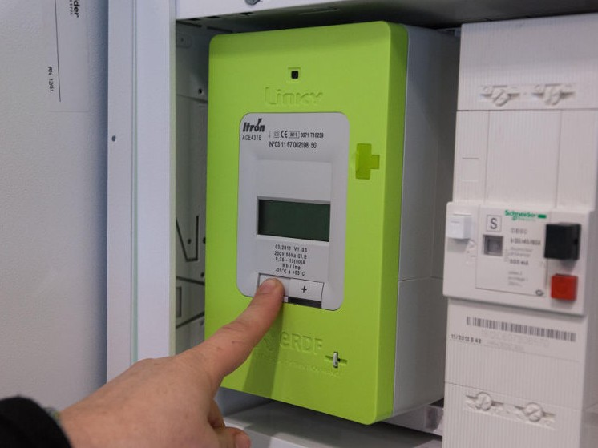

Slide 56
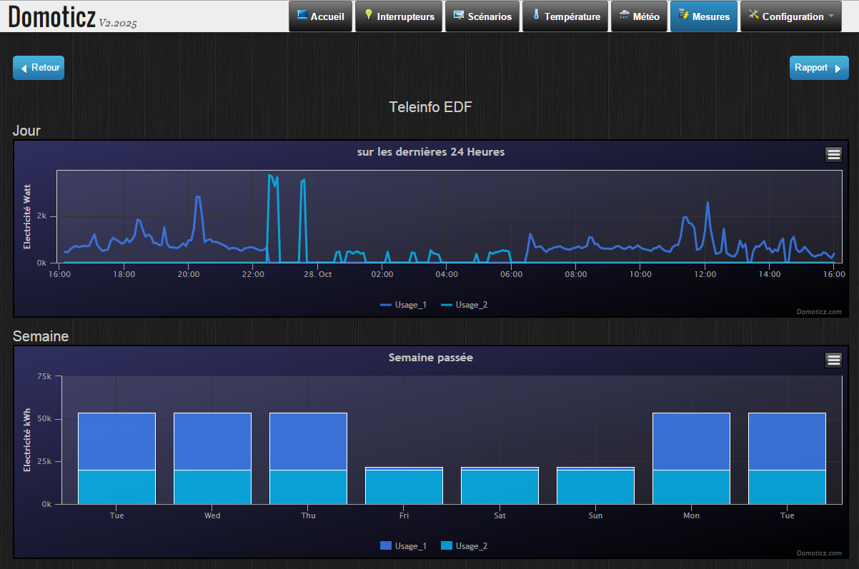

Slide 57
DEMO

Slide 58
Sensor

Slide 59
Observable sensor =
Observable.interval(1, TimeUnit.MILLISECONDS)
.map(
(time) -> {return device.getData(time);}
);

Slide 60
Observable sensor =
Observable.interval(1, TimeUnit.MILLISECONDS)
.map(
(time) -> {return device.getData(time);}
);

Slide 61
Observable sensor =
Observable.interval(1, TimeUnit.MILLISECONDS)
.map(
(time) -> {return device.getData(time);}
);

Slide 62
Observable sensor =
Observable.interval(1, TimeUnit.MILLISECONDS)
.map(
(time) -> {return device.getData(time);}
);

Slide 63
Sensor

Slide 64
Network Emitter

Slide 65
ZMQ.Socket publisher = context.socket(ZMQ.PUB);
publisher.bind("tcp://*:5556");
sensor.forEach(
(value) -> {publisher.send(data, 0);}
)
.subscribe();

Slide 66

ZMQ.Socket publisher = context.socket(ZMQ.PUB);
publisher.bind("tcp://*:5556");
sensor.forEach(
(value) -> {publisher.send(data, 0);}
)
.subscribe();

Slide 67
ZMQ.Socket publisher = context.socket(ZMQ.PUB);
publisher.bind("tcp://*:5556");
sensor.forEach(
(value) -> {publisher.send(data, 0);}
)
.subscribe();

Slide 68
ZMQ.Socket publisher = context.socket(ZMQ.PUB);
publisher.bind("tcp://*:5556");
sensor.forEach(
(value) -> {publisher.send(data, 0);}
)
.subscribe();

Slide 69
ZMQ.Socket publisher = context.socket(ZMQ.PUB);
publisher.bind("tcp://*:5556");
sensor.forEach(
(value) -> {publisher.send(data, 0);}
)
.subscribe();

Slide 70
Network Emitter

Slide 71
Network Receiver

Slide 72
ZMQ.Socket socket = context.socket(ZMQ.SUB);
socket.subscribe(new byte[0]);
socket.connect("tcp://localhost:5556");
Observable receiver = ZeroMQObservables.from(socket)

Slide 73
ZMQ.Socket socket = context.socket(ZMQ.SUB);
socket.subscribe(new byte[0]);
socket.connect("tcp://brehat:5556");
Observable receiver = ZeroMQObservables.from(socket)

Slide 74
ZMQ.Socket socket = context.socket(ZMQ.SUB);
socket.subscribe(new byte[0]);
socket.connect("tcp://localhost:5556");
Observable receiver = ZeroMQObservables.from(socket)

Slide 75
ZMQ.Socket socket = context.socket(ZMQ.SUB);
socket.subscribe(new byte[0]);
socket.connect("tcp://localhost:5556");
Observable receiver = ZeroMQObservables.from(socket)
Fonction perso (12 loc)

Slide 76
Network Receiver

Slide 77
GUI

Slide 78
XYDataset dataset =
new DynamicTimeSeriesCollection(…)
JFreeChart chart =
ChartFactory.createTimeSeriesChart(…, dataset, …);
receiver.
.observeOn(SwingScheduler.getInstance())
.forEach(
(data) -> {dataset.appendData(array);}
)
.subscribe();

Slide 79

XYDataset dataset =
new DynamicTimeSeriesCollection(…)
JFreeChart chart =
ChartFactory.createTimeSeriesChart(…, dataset, …);
receiver.
.observeOn(SwingScheduler.getInstance())
.forEach(
(data) -> {dataset.appendData(array);}
)
.subscribe();

Slide 80
XYDataset dataset =
new DynamicTimeSeriesCollection(…)
JFreeChart chart =
ChartFactory.createTimeSeriesChart(…, dataset, …);
receiver.
.observeOn(SwingScheduler.getInstance())
.forEach(
(data) -> {dataset.appendData(array);}
)
.subscribe();

Slide 81
XYDataset dataset =
new DynamicTimeSeriesCollection(…)
JFreeChart chart =
ChartFactory.createTimeSeriesChart(…, dataset, …);
receiver.
.observeOn(SwingScheduler.getInstance())
.forEach(
(data) -> {dataset.appendData(array);}
)
.subscribe();

Slide 82
XYDataset dataset =
new DynamicTimeSeriesCollection(…)
JFreeChart chart =
ChartFactory.createTimeSeriesChart(…, dataset, …);
receiver.
.observeOn(SwingScheduler.getInstance())
.forEach(
(data) -> {dataset.appendData(array);}
)
.subscribe();

Slide 83

Java Swing ?

Slide 84
Sensor
Network Emitter
Network Receiver
GUI

Slide 85


Sensor
Network Emitter
Network Receiver
GUI

Slide 86
DEMO

Slide 87
Network Receiver

Slide 88
function fromWebSocket(address) {
var ws = new WebSocket(address);
// Handle the data
var osbervable = Rx.Observable.create (function (obs) {
// Handle messages
ws.onmessage = obs.onNext.bind(obs);
ws.onerror = obs.onError.bind(obs);
ws.onclose = obs.onCompleted.bind(obs);
// Return way to unsubscribe
return ws.close.bind(ws);
});
return osbervable;
}

Slide 89
function fromWebSocket(address) {
var ws = new WebSocket(address);
// Handle the data
var osbervable = Rx.Observable.create (function (obs) {
// Handle messages
ws.onmessage = obs.onNext.bind(obs);
ws.onerror = obs.onError.bind(obs);
ws.onclose = obs.onCompleted.bind(obs);
// Return way to unsubscribe
return ws.close.bind(ws);
});
return osbervable;
}

Slide 90
function fromWebSocket(address) {
var ws = new WebSocket(address);
// Handle the data
var osbervable = Rx.Observable.create (function (obs) {
// Handle messages
ws.onmessage = obs.onNext.bind(obs);
ws.onerror = obs.onError.bind(obs);
ws.onclose = obs.onCompleted.bind(obs);
// Return way to unsubscribe
return ws.close.bind(ws);
});
return osbervable;
}

Slide 91
function fromWebSocket(address) {
var ws = new WebSocket(address);
// Handle the data
var osbervable = Rx.Observable.create (function (obs) {
// Handle messages
ws.onmessage = obs.onNext.bind(obs);
ws.onerror = obs.onError.bind(obs);
ws.onclose = obs.onCompleted.bind(obs);
// Return way to unsubscribe
return ws.close.bind(ws);
});
return osbervable;
}

Slide 92
function fromWebSocket(address) {
var ws = new WebSocket(address);
// Handle the data
var osbervable = Rx.Observable.create (function (obs) {
// Handle messages
ws.onmessage = obs.onNext.bind(obs);
ws.onerror = obs.onError.bind(obs);
ws.onclose = obs.onCompleted.bind(obs);
// Return way to unsubscribe
return ws.close.bind(ws);
});
return osbervable;
}

Slide 93
function fromWebSocket(address) {
var ws = new WebSocket(address);
// Handle the data
var osbervable = Rx.Observable.create (function (obs) {
// Handle messages
ws.onmessage = obs.onNext.bind(obs);
ws.onerror = obs.onError.bind(obs);
ws.onclose = obs.onCompleted.bind(obs);
// Return way to unsubscribe
return ws.close.bind(ws);
});
return osbervable;
}

Slide 94
Network Receiver

Slide 95
GUI

Slide 96
fromWebSocket('ws://localhost:8887/')
.throttleFirst(150)
.subscribe(
function (evt) {
var series = chart.series[0];
var x = (new Date()).getTime();
var y = parseFloat(evt.data);
series.addPoint([x,y], true, true);
});

Slide 97
fromWebSocket('ws://localhost:8887/')
.throttleFirst(150)
.subscribe(
function (evt) {
var series = chart.series[0];
var x = (new Date()).getTime();
var y = parseFloat(evt.data);
series.addPoint([x,y], true, true);
});

Slide 98
fromWebSocket('ws://localhost:8887/')
.throttleFirst(150)
.subscribe(
function (evt) {
var series = chart.series[0];
var x = (new Date()).getTime();
var y = parseFloat(evt.data);
series.addPoint([x,y], true, true);
});

Slide 99
fromWebSocket('ws://localhost:8887/')
.throttleFirst(150)
.subscribe(
function (evt) {
var series = chart.series[0];
var x = (new Date()).getTime();
var y = parseFloat(evt.data);
series.addPoint([x,y], true, true);
});

Slide 100
fromWebSocket('ws://localhost:8887/')
.throttleFirst(150)
.subscribe(
function (evt) {
var series = chart.series[0];
var x = (new Date()).getTime();
var y = parseFloat(evt.data);
series.addPoint([x,y], true, true);
});

Slide 101
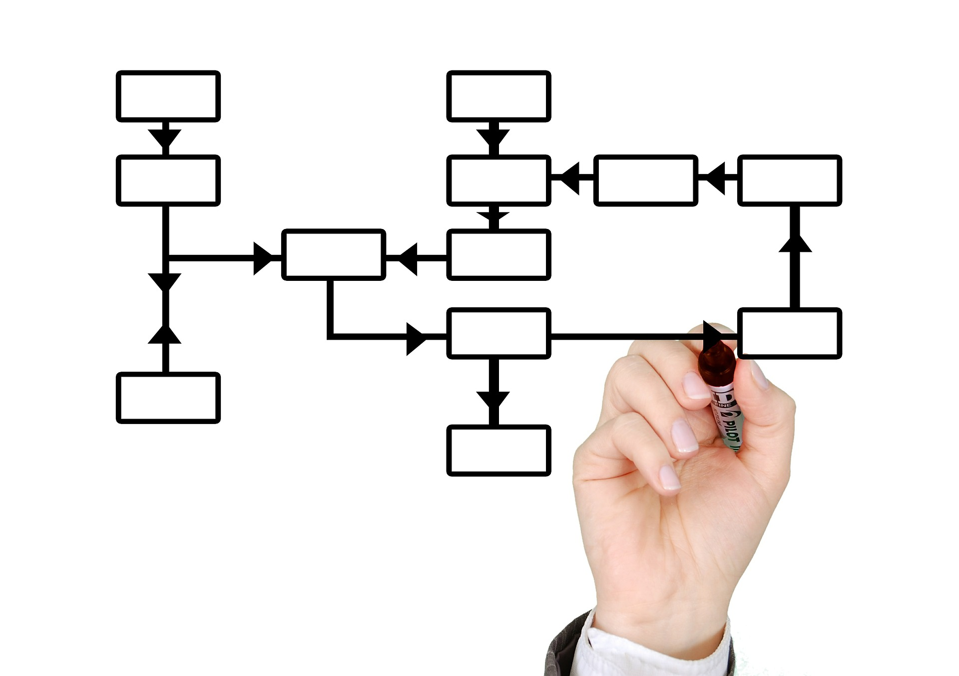

Slide 102
// Blocks
RandomSource source = new RandomSource();
MessageEmitter<Float> emitter = new MessageEmitter<>();
emitter.setConnectionString("tcp://*:5556");
WebSocketServerBlock webSocket = new WebSocketServerBlock();
webSocket.setAdress(8887);

Slide 103
// Blocks
RandomSource source = new RandomSource();
MessageEmitter<Float> emitter = new MessageEmitter<>();
emitter.setConnectionString("tcp://*:5556");
WebSocketServerBlock webSocket = new WebSocketServerBlock();
webSocket.setAdress(8887);
// Connexions
source.getOut().subscribe(emitter.getIn());
source.getOut().subscribe(webSocket.getIn());

Slide 104
// Blocks
DemoFrame frame = new DemoFrame("Test");
MessageReceiver<Float> receiver = new MessageReceiver<>();
receiver.setConnectionString("tcp://brehat:5556");

Slide 105
// Blocks
DemoFrame frame = new DemoFrame("Test");
MessageReceiver<Float> receiver = new MessageReceiver<>();
receiver.setConnectionString("tcp://brehat:5556");
// Connexions
receiver.getOut().subscribe(frame.getIn());

Slide 106

Dans mon projet ?

Slide 107

C# .NET

Slide 108
Java
C# .NET

Slide 109
JavaScript
Java
C# .NET

Slide 110
JavaScript
Java
C# .NET
Python

Slide 111
JavaScript
Java
C# .NET
Python
C++

Slide 112
JavaScript
Java
C# .NET
Ruby
Python
C++

Slide 113
Scala
JavaScript
Java
C# .NET
Ruby
Python
C++

Slide 114
Scala
JavaScript
Groovy
Java
C# .NET
Ruby
Python
C++

Slide 115
Scala
Clojure
JavaScript
Groovy
Java
C# .NET
Ruby
Python
C++

Slide 116
Scala
Clojure
JavaScript
Groovy
Java
JRuby
C# .NET
Ruby
Python
C++

Slide 117
Scala
Clojure
JavaScript
Groovy
Kotlin
Java
JRuby
C# .NET
Ruby
Python
C++

Slide 118
Scala
Clojure
JavaScript
Groovy
Kotlin
Java
JRuby
C# .NET
Ruby
Unity3D
Python
C++

Slide 119
Scala
Clojure
JavaScript
Groovy
Kotlin
Java
JRuby
Android
C# .NET
Ruby
Unity3D
Python
C++

Slide 120
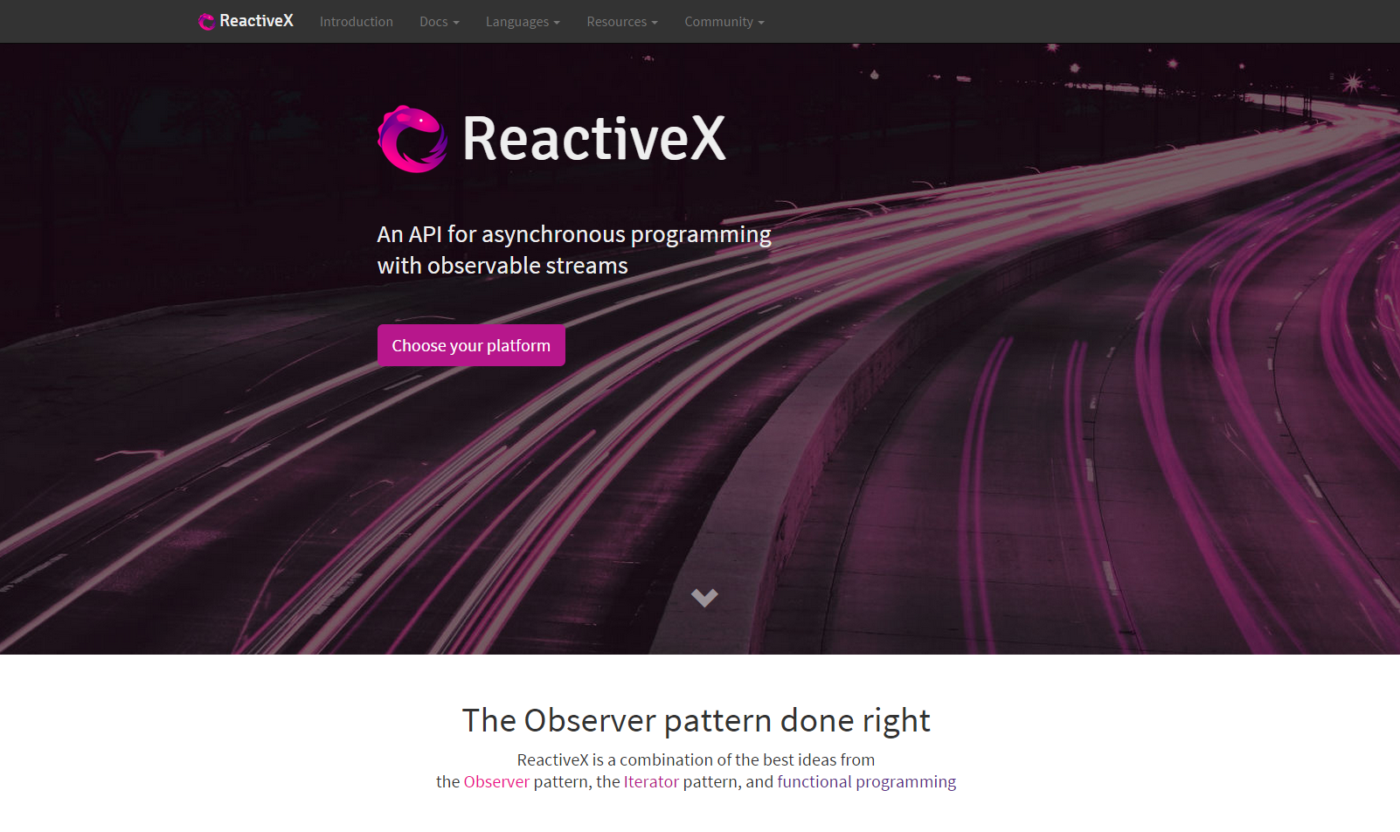

Slide 121
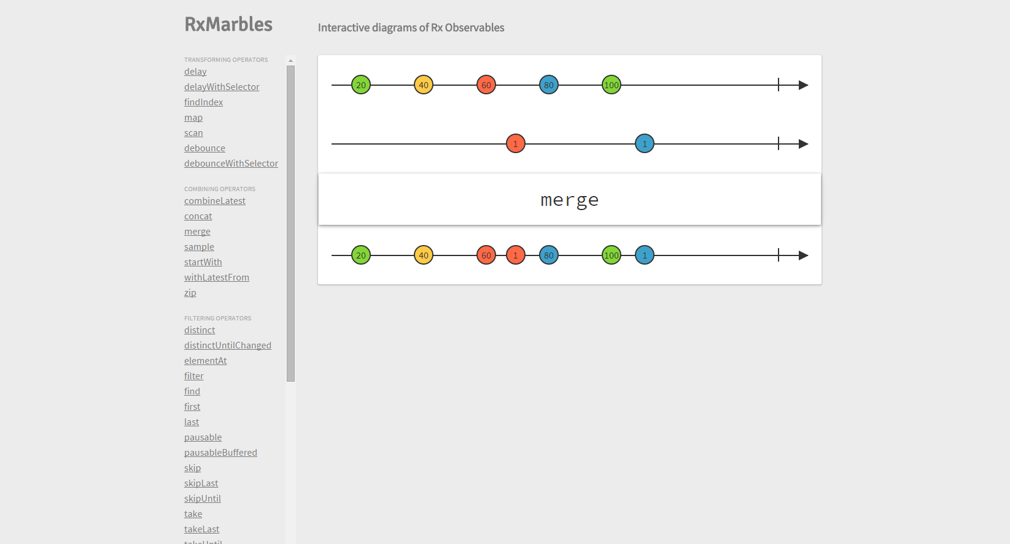

Slide 122
Questions ?

Slide 123
Ressources
http://reactivex.io/
http://rxmarbles.com/
http://jhusain.github.io/learnrx/
https://gist.github.com/staltz/868e7e9bc2a7b8c1f754
http://xgrommx.github.io/rx-book/

